Slide 1
Chapter 8: Memory

Slide 2

MEMORY
The study of memory looks at some of the following questions:
How do we process and store information?
Are there different types of memory?
How do we retrieve memories?
Why do we forget?

Slide 3
HOW MEMORY FUNCTIONS
Retrieval
Encoding
Awareness
Storage
Notes:
Memory is an information processing system like a computer. It is a set of processes used to encode, store and retrieve information over different periods of time.
Encoding involves the input of information into the memory system.
Storage is the retention of the encoded information.
Retrieval, is getting the information out of memory and back into awareness.

Slide 4
ENCODING
When the brain receives information from the environment it:
Labels/codes it.
Organizes it with other similar information.
Connects new concepts to existing concepts.
Notes:
Figure 8.3 (credit: Robert Couse-Baker)

Slide 5
ENCODING
Encoding occurs through 2 types of processing:
Automatic processing – encoding of details like time, space, frequency, and the meaning of words.
Usually done without conscious awareness.
E.g. remembering WHEN you last studied.
Effortful processing – encoding of details that takes time and effort.
E.g. WHAT you last studied, learning new skills.
Effortful → Automatic (with practice)
Notes:
When you first learn new skills such as driving a car, you have to put forth effort and attention to encode information about driving. Once you know how to drive, you can encode additional information about this skill automatically.

Slide 6
TYPES OF ENCODING (1)
Semantic encoding – encoding of words and their meanings.
Most effective form of encoding. Attaching meaning to information makes it easier to recall later.
Involves a deeper level of processing.
Levels-of-Processing (Craik & Lockhart, 1972)
  One’s degree of interaction with material at encoding is directly related to memory
Notes:
LOP == how much do you engage with the material?
More engagement == better memory

Slide 7
TYPES OF ENCODING (2)
Visual encoding – encoding of images.
Words that create a mental image, such as car, dog and book (concrete words) are easier to recall than words such as level, truth and value (abstract words).
Acoustic encoding – encoding of sounds.
Self-reference effect – the tendency for an individual to have better memory for information that relates to oneself in comparison to material that has less personal relevance.

Slide 8
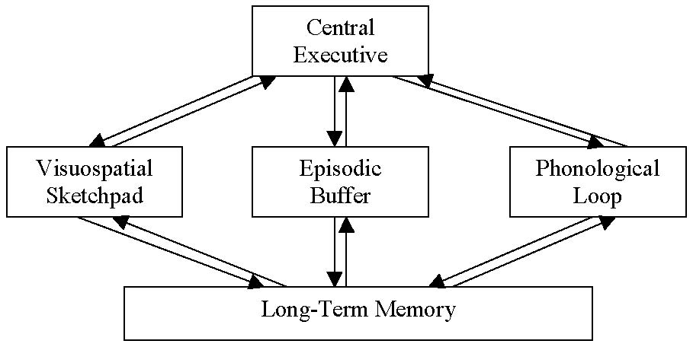
STORAGE: BADDELEY & HITCH MODEL
Baddeley and Hitch proposed a model of storage where short-term memory has different forms depending on the type of information received.
Storing memories is like opening different files on a computer and adding information.
3 short-term systems:
Visuospatial sketchpad
Episodic buffer
Phonological loop.
According to the model, a central executive supervises the flow of information between the systems.

Slide 9
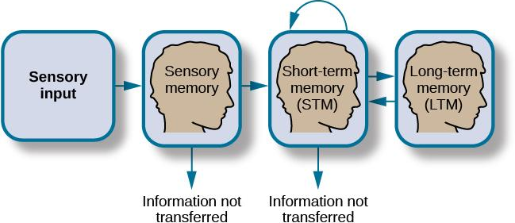
STORAGE: A-S MODEL
Storage is the creation of a permanent record of information.
Atkinson-Shiffrin Model of Memory
Information passes through three distinct stages in order for it to be stored in long-term memory.
Based on the belief that memories are processed the same way that a computer processes information.

Slide 10
SENSORY MEMORY
Sensory memory – storage of brief sensory events, such as sights, sounds, and tastes.
Stored for up to a couple of seconds.
First step of processing stimuli from the environment.
If the information is not important, it is discarded.
If the information is valuable then it moves into our short-term memory.

Slide 11

SHORT-TERM MEMORY (STM)
Short-term memory/working memory – a temporary storage system that processes incoming sensory memory.
Lasts about 20 seconds.
Capacity is usually about 7 items +/-2 (discovered by George Miller).
Short-term memories are either discarded or stored in long-term memory.
Memory consolidation – Transfer of STM to long-term memory.
One way memory consolidation can be achieved is through rehearsal.
Rehearsal – the conscious repetition of information to be remembered.
Notes:
RECALL EXERCISE:
Read each string of numbers out loud and have student write down what they can remember after each string to determine longest string of numbers they can remember.
9754, 68259, 913825, 5316842, 86951372, 719384273
6419, 67148, 648327, 5963827, 51739826, 163875942

Slide 12
Measuring Working Memory Span
How to measure working memory?
  Digit Span Test: https://www.memorylosstest.com/free-working-memory-tests-online/
  Operation Span (OSPAN) Test: https://app.gorilla.sc/openmaterials/503249
Notes:
Satisfies Learning Objective 2: Assess encoding, duration, and forgetting in working memory.
Goals of early research:
Early researchers believed that the brain had just one memory system that could be used in many different ways.
On this basis, they worked to demonstrate how working memory was different from long-term memory.
Free recall and serial position curve: The observation that participants remember items well from the beginning and end of a list but not from the middle.
A simple procedure, called “free recall,” was used in earlier research to demonstrate the separation of working memory from long-term memory.
In such a test, a list of words, usually randomly chosen and with little associative structure, is first read out to participants.
Then, participants are asked to recall as many of the words as possible.
The experimenters can examine the amount recalled as a function of serial position.
Important features of serial position curve:
Primacy effect: The observation that memory is usually superior for items at the beginning of a serial position curve; thought to be caused by the encoding of those items into long-term memory.
Recency effect: The observation that memory is usually superior for items at the end of a serial position curve; thought to be caused by the maintenance of those items in working memory.
Primacy and recency effects can be seen under a wide range of conditions.
Primacy effects result from the encoding of information into long-term memory.
Recency effects are based on retrieval from working memory.
Errors in recency effect tend to be based on sensory visual or auditory, errors.
Words written down tend to be remembered more than those that are attempted to be retrieved in order.
Different properties of working and long-term memories:
Variables affecting the primacy effect affect the long-term memory.
By contrast, variables affecting the recency effect are implicated in working memory.
Both primacy and recency effects exist in situations in which retrieval is strictly from long-term memory.

Slide 13
Attentional Control and WM
How well one can block out distractions and remain on task
  Strongly linked to WM capacity!
  Many ways to test!
    Two common methods: Task switching and Stroop Test
Notes:
Satisfies Learning Objective 2: Assess encoding, duration, and forgetting in working memory.
Goals of early research:
Early researchers believed that the brain had just one memory system that could be used in many different ways.
On this basis, they worked to demonstrate how working memory was different from long-term memory.
Free recall and serial position curve: The observation that participants remember items well from the beginning and end of a list but not from the middle.
A simple procedure, called “free recall,” was used in earlier research to demonstrate the separation of working memory from long-term memory.
In such a test, a list of words, usually randomly chosen and with little associative structure, is first read out to participants.
Then, participants are asked to recall as many of the words as possible.
The experimenters can examine the amount recalled as a function of serial position.
Important features of serial position curve:
Primacy effect: The observation that memory is usually superior for items at the beginning of a serial position curve; thought to be caused by the encoding of those items into long-term memory.
Recency effect: The observation that memory is usually superior for items at the end of a serial position curve; thought to be caused by the maintenance of those items in working memory.
Primacy and recency effects can be seen under a wide range of conditions.
Primacy effects result from the encoding of information into long-term memory.
Recency effects are based on retrieval from working memory.
Errors in recency effect tend to be based on sensory visual or auditory, errors.
Words written down tend to be remembered more than those that are attempted to be retrieved in order.
Different properties of working and long-term memories:
Variables affecting the primacy effect affect the long-term memory.
By contrast, variables affecting the recency effect are implicated in working memory.
Both primacy and recency effects exist in situations in which retrieval is strictly from long-term memory.

Slide 14
Attentional Control and STM
Stroop Color-Word Test (Stroop, 1935)
  Color words are printed in congruent (matching) or incongruent (non-matching) font colors
RED vs. RED
Task: Say the color the ink that the word is printed in
Notes:
Satisfies Learning Objective 2: Assess encoding, duration, and forgetting in working memory.
Goals of early research:
Early researchers believed that the brain had just one memory system that could be used in many different ways.
On this basis, they worked to demonstrate how working memory was different from long-term memory.
Free recall and serial position curve: The observation that participants remember items well from the beginning and end of a list but not from the middle.
A simple procedure, called “free recall,” was used in earlier research to demonstrate the separation of working memory from long-term memory.
In such a test, a list of words, usually randomly chosen and with little associative structure, is first read out to participants.
Then, participants are asked to recall as many of the words as possible.
The experimenters can examine the amount recalled as a function of serial position.
Important features of serial position curve:
Primacy effect: The observation that memory is usually superior for items at the beginning of a serial position curve; thought to be caused by the encoding of those items into long-term memory.
Recency effect: The observation that memory is usually superior for items at the end of a serial position curve; thought to be caused by the maintenance of those items in working memory.
Primacy and recency effects can be seen under a wide range of conditions.
Primacy effects result from the encoding of information into long-term memory.
Recency effects are based on retrieval from working memory.
Errors in recency effect tend to be based on sensory visual or auditory, errors.
Words written down tend to be remembered more than those that are attempted to be retrieved in order.
Different properties of working and long-term memories:
Variables affecting the primacy effect affect the long-term memory.
By contrast, variables affecting the recency effect are implicated in working memory.
Both primacy and recency effects exist in situations in which retrieval is strictly from long-term memory.

Slide 15
Stroop Test
BLUE
Notes:
Satisfies Learning Objective 2: Assess encoding, duration, and forgetting in working memory.
Goals of early research:
Early researchers believed that the brain had just one memory system that could be used in many different ways.
On this basis, they worked to demonstrate how working memory was different from long-term memory.
Free recall and serial position curve: The observation that participants remember items well from the beginning and end of a list but not from the middle.
A simple procedure, called “free recall,” was used in earlier research to demonstrate the separation of working memory from long-term memory.
In such a test, a list of words, usually randomly chosen and with little associative structure, is first read out to participants.
Then, participants are asked to recall as many of the words as possible.
The experimenters can examine the amount recalled as a function of serial position.
Important features of serial position curve:
Primacy effect: The observation that memory is usually superior for items at the beginning of a serial position curve; thought to be caused by the encoding of those items into long-term memory.
Recency effect: The observation that memory is usually superior for items at the end of a serial position curve; thought to be caused by the maintenance of those items in working memory.
Primacy and recency effects can be seen under a wide range of conditions.
Primacy effects result from the encoding of information into long-term memory.
Recency effects are based on retrieval from working memory.
Errors in recency effect tend to be based on sensory visual or auditory, errors.
Words written down tend to be remembered more than those that are attempted to be retrieved in order.
Different properties of working and long-term memories:
Variables affecting the primacy effect affect the long-term memory.
By contrast, variables affecting the recency effect are implicated in working memory.
Both primacy and recency effects exist in situations in which retrieval is strictly from long-term memory.

Slide 16
Stroop Test
GREEN
Notes:
Satisfies Learning Objective 2: Assess encoding, duration, and forgetting in working memory.
Goals of early research:
Early researchers believed that the brain had just one memory system that could be used in many different ways.
On this basis, they worked to demonstrate how working memory was different from long-term memory.
Free recall and serial position curve: The observation that participants remember items well from the beginning and end of a list but not from the middle.
A simple procedure, called “free recall,” was used in earlier research to demonstrate the separation of working memory from long-term memory.
In such a test, a list of words, usually randomly chosen and with little associative structure, is first read out to participants.
Then, participants are asked to recall as many of the words as possible.
The experimenters can examine the amount recalled as a function of serial position.
Important features of serial position curve:
Primacy effect: The observation that memory is usually superior for items at the beginning of a serial position curve; thought to be caused by the encoding of those items into long-term memory.
Recency effect: The observation that memory is usually superior for items at the end of a serial position curve; thought to be caused by the maintenance of those items in working memory.
Primacy and recency effects can be seen under a wide range of conditions.
Primacy effects result from the encoding of information into long-term memory.
Recency effects are based on retrieval from working memory.
Errors in recency effect tend to be based on sensory visual or auditory, errors.
Words written down tend to be remembered more than those that are attempted to be retrieved in order.
Different properties of working and long-term memories:
Variables affecting the primacy effect affect the long-term memory.
By contrast, variables affecting the recency effect are implicated in working memory.
Both primacy and recency effects exist in situations in which retrieval is strictly from long-term memory.

Slide 17
Stroop Test
RED
Notes:
Satisfies Learning Objective 2: Assess encoding, duration, and forgetting in working memory.
Goals of early research:
Early researchers believed that the brain had just one memory system that could be used in many different ways.
On this basis, they worked to demonstrate how working memory was different from long-term memory.
Free recall and serial position curve: The observation that participants remember items well from the beginning and end of a list but not from the middle.
A simple procedure, called “free recall,” was used in earlier research to demonstrate the separation of working memory from long-term memory.
In such a test, a list of words, usually randomly chosen and with little associative structure, is first read out to participants.
Then, participants are asked to recall as many of the words as possible.
The experimenters can examine the amount recalled as a function of serial position.
Important features of serial position curve:
Primacy effect: The observation that memory is usually superior for items at the beginning of a serial position curve; thought to be caused by the encoding of those items into long-term memory.
Recency effect: The observation that memory is usually superior for items at the end of a serial position curve; thought to be caused by the maintenance of those items in working memory.
Primacy and recency effects can be seen under a wide range of conditions.
Primacy effects result from the encoding of information into long-term memory.
Recency effects are based on retrieval from working memory.
Errors in recency effect tend to be based on sensory visual or auditory, errors.
Words written down tend to be remembered more than those that are attempted to be retrieved in order.
Different properties of working and long-term memories:
Variables affecting the primacy effect affect the long-term memory.
By contrast, variables affecting the recency effect are implicated in working memory.
Both primacy and recency effects exist in situations in which retrieval is strictly from long-term memory.

Slide 18
Stroop Test
YELLOW
Notes:
Satisfies Learning Objective 2: Assess encoding, duration, and forgetting in working memory.
Goals of early research:
Early researchers believed that the brain had just one memory system that could be used in many different ways.
On this basis, they worked to demonstrate how working memory was different from long-term memory.
Free recall and serial position curve: The observation that participants remember items well from the beginning and end of a list but not from the middle.
A simple procedure, called “free recall,” was used in earlier research to demonstrate the separation of working memory from long-term memory.
In such a test, a list of words, usually randomly chosen and with little associative structure, is first read out to participants.
Then, participants are asked to recall as many of the words as possible.
The experimenters can examine the amount recalled as a function of serial position.
Important features of serial position curve:
Primacy effect: The observation that memory is usually superior for items at the beginning of a serial position curve; thought to be caused by the encoding of those items into long-term memory.
Recency effect: The observation that memory is usually superior for items at the end of a serial position curve; thought to be caused by the maintenance of those items in working memory.
Primacy and recency effects can be seen under a wide range of conditions.
Primacy effects result from the encoding of information into long-term memory.
Recency effects are based on retrieval from working memory.
Errors in recency effect tend to be based on sensory visual or auditory, errors.
Words written down tend to be remembered more than those that are attempted to be retrieved in order.
Different properties of working and long-term memories:
Variables affecting the primacy effect affect the long-term memory.
By contrast, variables affecting the recency effect are implicated in working memory.
Both primacy and recency effects exist in situations in which retrieval is strictly from long-term memory.

Slide 19
Stroop Test
GREEN
Notes:
Satisfies Learning Objective 2: Assess encoding, duration, and forgetting in working memory.
Goals of early research:
Early researchers believed that the brain had just one memory system that could be used in many different ways.
On this basis, they worked to demonstrate how working memory was different from long-term memory.
Free recall and serial position curve: The observation that participants remember items well from the beginning and end of a list but not from the middle.
A simple procedure, called “free recall,” was used in earlier research to demonstrate the separation of working memory from long-term memory.
In such a test, a list of words, usually randomly chosen and with little associative structure, is first read out to participants.
Then, participants are asked to recall as many of the words as possible.
The experimenters can examine the amount recalled as a function of serial position.
Important features of serial position curve:
Primacy effect: The observation that memory is usually superior for items at the beginning of a serial position curve; thought to be caused by the encoding of those items into long-term memory.
Recency effect: The observation that memory is usually superior for items at the end of a serial position curve; thought to be caused by the maintenance of those items in working memory.
Primacy and recency effects can be seen under a wide range of conditions.
Primacy effects result from the encoding of information into long-term memory.
Recency effects are based on retrieval from working memory.
Errors in recency effect tend to be based on sensory visual or auditory, errors.
Words written down tend to be remembered more than those that are attempted to be retrieved in order.
Different properties of working and long-term memories:
Variables affecting the primacy effect affect the long-term memory.
By contrast, variables affecting the recency effect are implicated in working memory.
Both primacy and recency effects exist in situations in which retrieval is strictly from long-term memory.

Slide 20
Stroop Test
YELLOW
Notes:
Satisfies Learning Objective 2: Assess encoding, duration, and forgetting in working memory.
Goals of early research:
Early researchers believed that the brain had just one memory system that could be used in many different ways.
On this basis, they worked to demonstrate how working memory was different from long-term memory.
Free recall and serial position curve: The observation that participants remember items well from the beginning and end of a list but not from the middle.
A simple procedure, called “free recall,” was used in earlier research to demonstrate the separation of working memory from long-term memory.
In such a test, a list of words, usually randomly chosen and with little associative structure, is first read out to participants.
Then, participants are asked to recall as many of the words as possible.
The experimenters can examine the amount recalled as a function of serial position.
Important features of serial position curve:
Primacy effect: The observation that memory is usually superior for items at the beginning of a serial position curve; thought to be caused by the encoding of those items into long-term memory.
Recency effect: The observation that memory is usually superior for items at the end of a serial position curve; thought to be caused by the maintenance of those items in working memory.
Primacy and recency effects can be seen under a wide range of conditions.
Primacy effects result from the encoding of information into long-term memory.
Recency effects are based on retrieval from working memory.
Errors in recency effect tend to be based on sensory visual or auditory, errors.
Words written down tend to be remembered more than those that are attempted to be retrieved in order.
Different properties of working and long-term memories:
Variables affecting the primacy effect affect the long-term memory.
By contrast, variables affecting the recency effect are implicated in working memory.
Both primacy and recency effects exist in situations in which retrieval is strictly from long-term memory.

Slide 21
Stroop Test
YELLOW
Notes:
Satisfies Learning Objective 2: Assess encoding, duration, and forgetting in working memory.
Goals of early research:
Early researchers believed that the brain had just one memory system that could be used in many different ways.
On this basis, they worked to demonstrate how working memory was different from long-term memory.
Free recall and serial position curve: The observation that participants remember items well from the beginning and end of a list but not from the middle.
A simple procedure, called “free recall,” was used in earlier research to demonstrate the separation of working memory from long-term memory.
In such a test, a list of words, usually randomly chosen and with little associative structure, is first read out to participants.
Then, participants are asked to recall as many of the words as possible.
The experimenters can examine the amount recalled as a function of serial position.
Important features of serial position curve:
Primacy effect: The observation that memory is usually superior for items at the beginning of a serial position curve; thought to be caused by the encoding of those items into long-term memory.
Recency effect: The observation that memory is usually superior for items at the end of a serial position curve; thought to be caused by the maintenance of those items in working memory.
Primacy and recency effects can be seen under a wide range of conditions.
Primacy effects result from the encoding of information into long-term memory.
Recency effects are based on retrieval from working memory.
Errors in recency effect tend to be based on sensory visual or auditory, errors.
Words written down tend to be remembered more than those that are attempted to be retrieved in order.
Different properties of working and long-term memories:
Variables affecting the primacy effect affect the long-term memory.
By contrast, variables affecting the recency effect are implicated in working memory.
Both primacy and recency effects exist in situations in which retrieval is strictly from long-term memory.

Slide 22
Stroop Test
BLUE
Notes:
Satisfies Learning Objective 2: Assess encoding, duration, and forgetting in working memory.
Goals of early research:
Early researchers believed that the brain had just one memory system that could be used in many different ways.
On this basis, they worked to demonstrate how working memory was different from long-term memory.
Free recall and serial position curve: The observation that participants remember items well from the beginning and end of a list but not from the middle.
A simple procedure, called “free recall,” was used in earlier research to demonstrate the separation of working memory from long-term memory.
In such a test, a list of words, usually randomly chosen and with little associative structure, is first read out to participants.
Then, participants are asked to recall as many of the words as possible.
The experimenters can examine the amount recalled as a function of serial position.
Important features of serial position curve:
Primacy effect: The observation that memory is usually superior for items at the beginning of a serial position curve; thought to be caused by the encoding of those items into long-term memory.
Recency effect: The observation that memory is usually superior for items at the end of a serial position curve; thought to be caused by the maintenance of those items in working memory.
Primacy and recency effects can be seen under a wide range of conditions.
Primacy effects result from the encoding of information into long-term memory.
Recency effects are based on retrieval from working memory.
Errors in recency effect tend to be based on sensory visual or auditory, errors.
Words written down tend to be remembered more than those that are attempted to be retrieved in order.
Different properties of working and long-term memories:
Variables affecting the primacy effect affect the long-term memory.
By contrast, variables affecting the recency effect are implicated in working memory.
Both primacy and recency effects exist in situations in which retrieval is strictly from long-term memory.

Slide 23
Stroop Test
RED
Notes:
Satisfies Learning Objective 2: Assess encoding, duration, and forgetting in working memory.
Goals of early research:
Early researchers believed that the brain had just one memory system that could be used in many different ways.
On this basis, they worked to demonstrate how working memory was different from long-term memory.
Free recall and serial position curve: The observation that participants remember items well from the beginning and end of a list but not from the middle.
A simple procedure, called “free recall,” was used in earlier research to demonstrate the separation of working memory from long-term memory.
In such a test, a list of words, usually randomly chosen and with little associative structure, is first read out to participants.
Then, participants are asked to recall as many of the words as possible.
The experimenters can examine the amount recalled as a function of serial position.
Important features of serial position curve:
Primacy effect: The observation that memory is usually superior for items at the beginning of a serial position curve; thought to be caused by the encoding of those items into long-term memory.
Recency effect: The observation that memory is usually superior for items at the end of a serial position curve; thought to be caused by the maintenance of those items in working memory.
Primacy and recency effects can be seen under a wide range of conditions.
Primacy effects result from the encoding of information into long-term memory.
Recency effects are based on retrieval from working memory.
Errors in recency effect tend to be based on sensory visual or auditory, errors.
Words written down tend to be remembered more than those that are attempted to be retrieved in order.
Different properties of working and long-term memories:
Variables affecting the primacy effect affect the long-term memory.
By contrast, variables affecting the recency effect are implicated in working memory.
Both primacy and recency effects exist in situations in which retrieval is strictly from long-term memory.

Slide 24
Stroop Test
GREEN
Notes:
Satisfies Learning Objective 2: Assess encoding, duration, and forgetting in working memory.
Goals of early research:
Early researchers believed that the brain had just one memory system that could be used in many different ways.
On this basis, they worked to demonstrate how working memory was different from long-term memory.
Free recall and serial position curve: The observation that participants remember items well from the beginning and end of a list but not from the middle.
A simple procedure, called “free recall,” was used in earlier research to demonstrate the separation of working memory from long-term memory.
In such a test, a list of words, usually randomly chosen and with little associative structure, is first read out to participants.
Then, participants are asked to recall as many of the words as possible.
The experimenters can examine the amount recalled as a function of serial position.
Important features of serial position curve:
Primacy effect: The observation that memory is usually superior for items at the beginning of a serial position curve; thought to be caused by the encoding of those items into long-term memory.
Recency effect: The observation that memory is usually superior for items at the end of a serial position curve; thought to be caused by the maintenance of those items in working memory.
Primacy and recency effects can be seen under a wide range of conditions.
Primacy effects result from the encoding of information into long-term memory.
Recency effects are based on retrieval from working memory.
Errors in recency effect tend to be based on sensory visual or auditory, errors.
Words written down tend to be remembered more than those that are attempted to be retrieved in order.
Different properties of working and long-term memories:
Variables affecting the primacy effect affect the long-term memory.
By contrast, variables affecting the recency effect are implicated in working memory.
Both primacy and recency effects exist in situations in which retrieval is strictly from long-term memory.

Slide 26
Stroop Test: Common Findings
More errors on incongruent trials
Incongruent trials slower, especially following a series of congruent trials
Better WM capacity correlates with better performance
Online Stroop Test:
https://faculty.washington.edu/chudler/java/ready.html
Notes:
Satisfies Learning Objective 2: Assess encoding, duration, and forgetting in working memory.
Goals of early research:
Early researchers believed that the brain had just one memory system that could be used in many different ways.
On this basis, they worked to demonstrate how working memory was different from long-term memory.
Free recall and serial position curve: The observation that participants remember items well from the beginning and end of a list but not from the middle.
A simple procedure, called “free recall,” was used in earlier research to demonstrate the separation of working memory from long-term memory.
In such a test, a list of words, usually randomly chosen and with little associative structure, is first read out to participants.
Then, participants are asked to recall as many of the words as possible.
The experimenters can examine the amount recalled as a function of serial position.
Important features of serial position curve:
Primacy effect: The observation that memory is usually superior for items at the beginning of a serial position curve; thought to be caused by the encoding of those items into long-term memory.
Recency effect: The observation that memory is usually superior for items at the end of a serial position curve; thought to be caused by the maintenance of those items in working memory.
Primacy and recency effects can be seen under a wide range of conditions.
Primacy effects result from the encoding of information into long-term memory.
Recency effects are based on retrieval from working memory.
Errors in recency effect tend to be based on sensory visual or auditory, errors.
Words written down tend to be remembered more than those that are attempted to be retrieved in order.
Different properties of working and long-term memories:
Variables affecting the primacy effect affect the long-term memory.
By contrast, variables affecting the recency effect are implicated in working memory.
Both primacy and recency effects exist in situations in which retrieval is strictly from long-term memory.

Slide 27
Position Effects and WM
The order in which objects are studied can also affect memory
Notes:
Satisfies Learning Objective 2: Assess encoding, duration, and forgetting in working memory.
Goals of early research:
Early researchers believed that the brain had just one memory system that could be used in many different ways.
On this basis, they worked to demonstrate how working memory was different from long-term memory.
Free recall and serial position curve: The observation that participants remember items well from the beginning and end of a list but not from the middle.
A simple procedure, called “free recall,” was used in earlier research to demonstrate the separation of working memory from long-term memory.
In such a test, a list of words, usually randomly chosen and with little associative structure, is first read out to participants.
Then, participants are asked to recall as many of the words as possible.
The experimenters can examine the amount recalled as a function of serial position.
Important features of serial position curve:
Primacy effect: The observation that memory is usually superior for items at the beginning of a serial position curve; thought to be caused by the encoding of those items into long-term memory.
Recency effect: The observation that memory is usually superior for items at the end of a serial position curve; thought to be caused by the maintenance of those items in working memory.
Primacy and recency effects can be seen under a wide range of conditions.
Primacy effects result from the encoding of information into long-term memory.
Recency effects are based on retrieval from working memory.
Errors in recency effect tend to be based on sensory visual or auditory, errors.
Words written down tend to be remembered more than those that are attempted to be retrieved in order.
Different properties of working and long-term memories:
Variables affecting the primacy effect affect the long-term memory.
By contrast, variables affecting the recency effect are implicated in working memory.
Both primacy and recency effects exist in situations in which retrieval is strictly from long-term memory.

Slide 28
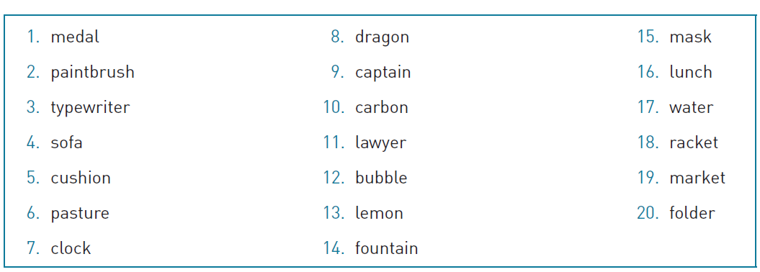
Memory Activity
Notes:
Satisfies Learning Objective 2: Assess encoding, duration, and forgetting in working memory.
Figure 3.6: Read aloud the following words. Immediately after reading the words, write down as many as you can. Then plot your total recall as a function of input order. However, you do not have to recall the words in order.

Slide 29
Memory Activity
Notes:
Satisfies Learning Objective 2: Assess encoding, duration, and forgetting in working memory.
Figure 3.6: Read aloud the following words. Immediately after reading the words, write down as many as you can. Then plot your total recall as a function of input order. However, you do not have to recall the words in order.

Slide 30
Memory Activity
Notes:
Satisfies Learning Objective 2: Assess encoding, duration, and forgetting in working memory.
Figure 3.6: Read aloud the following words. Immediately after reading the words, write down as many as you can. Then plot your total recall as a function of input order. However, you do not have to recall the words in order.

Slide 31
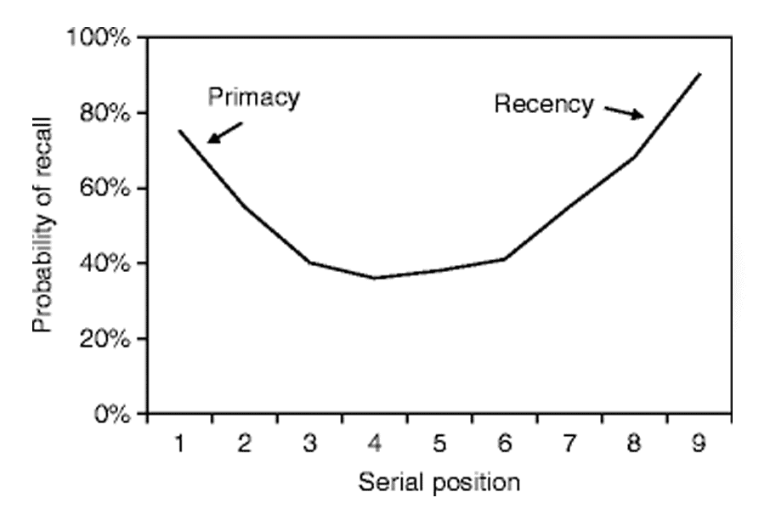
Notes:
Satisfies Learning Objective 2: Assess encoding, duration, and forgetting in working memory.
Goals of early research:
Early researchers believed that the brain had just one memory system that could be used in many different ways.
On this basis, they worked to demonstrate how working memory was different from long-term memory.
Free recall and serial position curve: The observation that participants remember items well from the beginning and end of a list but not from the middle.
A simple procedure, called “free recall,” was used in earlier research to demonstrate the separation of working memory from long-term memory.
In such a test, a list of words, usually randomly chosen and with little associative structure, is first read out to participants.
Then, participants are asked to recall as many of the words as possible.
The experimenters can examine the amount recalled as a function of serial position.
Important features of serial position curve:
Primacy effect: The observation that memory is usually superior for items at the beginning of a serial position curve; thought to be caused by the encoding of those items into long-term memory.
Recency effect: The observation that memory is usually superior for items at the end of a serial position curve; thought to be caused by the maintenance of those items in working memory.
Primacy and recency effects can be seen under a wide range of conditions.
Primacy effects result from the encoding of information into long-term memory.
Recency effects are based on retrieval from working memory.
Errors in recency effect tend to be based on sensory visual or auditory, errors.
Words written down tend to be remembered more than those that are attempted to be retrieved in order.
Different properties of working and long-term memories:
Variables affecting the primacy effect affect the long-term memory.
By contrast, variables affecting the recency effect are implicated in working memory.
Both primacy and recency effects exist in situations in which retrieval is strictly from long-term memory.

Slide 32
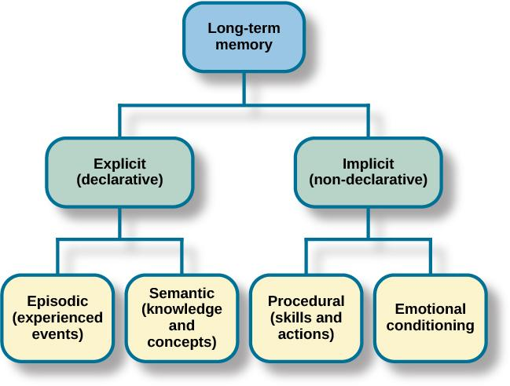
LONG-TERM MEMORY (LTM)
LTM is the continuous storage of information.
It has no limit and is like the information you store on the hard drive of a computer.
There are two components of long-term memory: explicit and implicit.

Slide 33
LTM: EXPLICIT MEMORY
Explicit (declarative) memory – memories of facts and events we can consciously remember and recall/declare.
Explicit memories include two types:
Semantic – knowledge about words, concepts and language.
Knowing who the President is.
Episodic – information about events we have personally experienced.
Remembering your 5th birthday party.
The what, where, when of an event.
Also called autobiographical memory.
A small number of people have a highly superior autobigraphical memory known as hyperthymesia.
Notes:
Semantic = what; Episodic = who, when, where of an event

Slide 34
Autobiographical Memory
Autobiographical memories: Personal memories
  Examples?
Wide variety of content!
  Memorable events, mundane events, etc.
Have episodic AND semantic components!
Notes:
Flashbulb memories: Highly confident personal memories of surprising events. To study them, researchers have focused on public tragedies.
There can also be flashbulb memories of personal events, but public events are more advantageous for study because a large number of people experience the same, unexpected event.
Flashbulb memories can also be of positive events.
Characteristics of autobiographical memories:
Not all such memories need be of the traumatic kind.
They can be memorable events, like the first day at a new job, or mundane events, such as your breakfast on a morning.
Nature of autobiographical memories: They can be capricious, involuntary, or of inconsequential meaning.
A function of memory:
Autobiographical memory refers to specific memories (episodic memory) and self-knowledge (semantic memory).
It does not define a system of memory, but rather a function of memory.

Slide 35
Explicit Memory and Encoding (1)
Levels of Processing (Craik & Lockhart, 1972)
Incidental vs. intentional learning.
  Episodic memory is encoded as a byproduct of perceiving and understanding the world (Incidental)
  Semantic memory is intentional (active, usually know that memory will be tested)
Different depths of processing.
Notes:
Satisfies Learning Objective 3: Describe levels of processing and other factors that affect encoding.
Concept of levels of processing: More meaningful handling of information leads to better encoding of that information.
Theorized by Craik and Lockhart: Fergus Craik and Robert Lockhart developed the theory of levels of processing in the early 1970s.
Incidental and intentional learning:
Incidental learning: People encode information not through active efforts to remember but rather as a by-product of perceiving and understanding the world.
Intentional learning: People actively engage in learning information, because they know that their memories may be tested.
Incidental learning is considered as an important aspect of cognition, as argued by Craik and Lockhart.
Different depths of processing:
The manner in which information is first encountered and rehearsed leads to a different depth of processing.
Elaborative rehearsal: Processing the meaning of information in working memory.
Maintenance rehearsal: Repeating information over and over.
Shallow processing: Processing information by using maintenance rehearsal or processing for sensory characteristics to produce less remembering than deep processing.
Deep processing: Processing information by using elaborative or meaningful processing to produce more remembering than shallow processing.

Slide 36
Explicit Memory and Encoding (2)
Levels of Processing (LOP; Craik & Lockhart, 1972)
Different depths of processing: More meaningful handling of information == better encoding
Better encoding == better memory for information
Notes:
Satisfies Learning Objective 3: Describe levels of processing and other factors that affect encoding.
Concept of levels of processing: More meaningful handling of information leads to better encoding of that information.
Theorized by Craik and Lockhart: Fergus Craik and Robert Lockhart developed the theory of levels of processing in the early 1970s.
Incidental and intentional learning:
Incidental learning: People encode information not through active efforts to remember but rather as a by-product of perceiving and understanding the world.
Intentional learning: People actively engage in learning information, because they know that their memories may be tested.
Incidental learning is considered as an important aspect of cognition, as argued by Craik and Lockhart.
Different depths of processing:
The manner in which information is first encountered and rehearsed leads to a different depth of processing.
Elaborative rehearsal: Processing the meaning of information in working memory.
Maintenance rehearsal: Repeating information over and over.
Shallow processing: Processing information by using maintenance rehearsal or processing for sensory characteristics to produce less remembering than deep processing.
Deep processing: Processing information by using elaborative or meaningful processing to produce more remembering than shallow processing.

Slide 37
Testing Levels of Processing (1)
“Orienting tasks” – Having participants focus on specific aspects of stimuli
Shallow tasks?
Deep tasks?
Notes:
Satisfies Learning Objective 3: Describe levels of processing and other factors that affect encoding.
Hypothesis by Craik and Lockhart:
When information is processed more deeply, using elaborative or meaningful processing, it is more likely to be remembered.
When information is processed more shallowly, using maintenance rehearsal or processing for sensory characteristics, it is remembered less.
Testing the hypothesis:
In a landmark study, Craik and Tulving employed several new methods, now considered standard in memory research.
Orienting tasks: Direct the participant’s attention to some aspect of the stimuli—either deep or shallow—but do not alert the participant to the potential of a later memory test.
The experimental hypothesis was successfully demonstrated.
Implications and applications:
Memory can be improved by simply using deep or meaning-based encoding strategies without any additional investment of time and effort.
Memory for visual information can also be improved through deep levels of processing.
According to the results of an experimental study by Craik and Watkins, maintenance rehearsal allows people to keep information in working memory but does not create good long-term memory, episodic or otherwise.
Critics of the approach:
A circular theory that does not separately define deep processing from good memory performance.
To counter this criticism, Fisher and Craik demonstrated how, under some conditions, deep processing can produce worse memory performance than shallow processing.

Slide 38
Testing Levels of Processing (2)
Survival Processing: Processing information based on its survival value boosts encoding
Nairne et al. (2007): Participants rated words based on surviving on “the grasslands of a foreign land”
Improved memory vs. other “deep” tasks
Notes:
Satisfies Learning Objective 3: Describe levels of processing and other factors that affect encoding.
Survival processing: Processing information in terms of its value to surviving in the wild is a surprisingly effective manner in which to encode information.
Defined and tested by Narine et al.:
Based on their observations of participants who rated a group of unrelated words in terms of how relevant they were to surviving on the grasslands of a foreign land.
The subsequent memory of these words was compared with those learned using other orienting tasks.
Nairne argued that a memory system that operated this way would be selected over evolutionary time.
Proximate causes:
Theorized by Bell et al.
Survival processing activates threat mechanisms.
Survival processing causes us to focus on the potential function of the objects or ideas the words represents.
Therefore, function is important in explaining survival processing.
Ultimate deep-level processing: Survival processing instantly focuses us on the meaning of the words.

Slide 39
Survival Processing (1)
Why is survival processing beneficial to memory?
  Focus on object’s function?
  Threat activation?
Notes:
Satisfies Learning Objective 3: Describe levels of processing and other factors that affect encoding.
Survival processing: Processing information in terms of its value to surviving in the wild is a surprisingly effective manner in which to encode information.
Defined and tested by Narine et al.:
Based on their observations of participants who rated a group of unrelated words in terms of how relevant they were to surviving on the grasslands of a foreign land.
The subsequent memory of these words was compared with those learned using other orienting tasks.
Nairne argued that a memory system that operated this way would be selected over evolutionary time.
Proximate causes:
Theorized by Bell et al.
Survival processing activates threat mechanisms.
Survival processing causes us to focus on the potential function of the objects or ideas the words represents.
Therefore, function is important in explaining survival processing.
Ultimate deep-level processing: Survival processing instantly focuses us on the meaning of the words.

Slide 40
Survival Processing (2)
Follow-up study: Soderstrom & McCabe (2011)
Manipulated Setting: Modern City vs. Grasslands
Manipulated Reality: Attackers vs. Zombies
Compared to a pleasantness rating control group (general deep task)
Predictions?
Notes:
Satisfies Learning Objective 3: Describe levels of processing and other factors that affect encoding.
Survival processing: Processing information in terms of its value to surviving in the wild is a surprisingly effective manner in which to encode information.
Defined and tested by Narine et al.:
Based on their observations of participants who rated a group of unrelated words in terms of how relevant they were to surviving on the grasslands of a foreign land.
The subsequent memory of these words was compared with those learned using other orienting tasks.
Nairne argued that a memory system that operated this way would be selected over evolutionary time.
Proximate causes:
Theorized by Bell et al.
Survival processing activates threat mechanisms.
Survival processing causes us to focus on the potential function of the objects or ideas the words represents.
Therefore, function is important in explaining survival processing.
Ultimate deep-level processing: Survival processing instantly focuses us on the meaning of the words.

Slide 41
Survival Processing (3)
Notes:
Satisfies Learning Objective 3: Describe levels of processing and other factors that affect encoding.
Survival processing: Processing information in terms of its value to surviving in the wild is a surprisingly effective manner in which to encode information.
Defined and tested by Narine et al.:
Based on their observations of participants who rated a group of unrelated words in terms of how relevant they were to surviving on the grasslands of a foreign land.
The subsequent memory of these words was compared with those learned using other orienting tasks.
Nairne argued that a memory system that operated this way would be selected over evolutionary time.
Proximate causes:
Theorized by Bell et al.
Survival processing activates threat mechanisms.
Survival processing causes us to focus on the potential function of the objects or ideas the words represents.
Therefore, function is important in explaining survival processing.
Ultimate deep-level processing: Survival processing instantly focuses us on the meaning of the words.

Slide 42
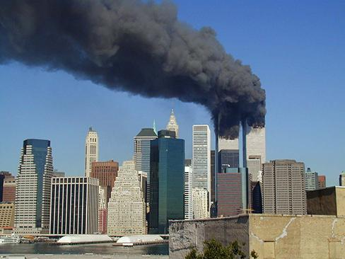
Flashbulb Memories (1)
Flash bulb memory – a record of an atypical and unusual event that has very strong emotional associations.
Most people can remember where they were when they first heard about the 9/11 terrorist attacks.

Slide 43
Flashbulb Memories (2)
Provided by momentous events.
Public events are typically studied.
  Why?
Multicity study by Hirst et al.
  Flashbulb memories for 9/11
  Negative emotions were forgotten over time
Notes:
Satisfies Learning Objective 2: Demonstrate an understanding of the phenomena of childhood amnesia, flashbulb memory, and collaborative memory.
Provided by momentous events: Momentous events in history provide people with strong memories of where they were and what they were doing.
Public events are typically studied:
This is advantageous as researchers can gather information from many people about the same event.
However, flashbulb memories can also be of personal events.
First empirical study:
Concerned Americans’ memories for the spate of dreadful assassinations in the 1960s, albeit done several years after the murders.
It could not address the accuracy of the reported memories.
However, despite the passage of time, people claimed to have vivid memories of some of the events.
The older memories were just as strong later ones.
The more relevant an event was to someone, he/she was more likely to have a flashbulb memory.
The interesting findings from this study led Brown and Kulik to conclude that the term flashbulb “fit.”
Multicity study by Hirst et al.:
The researchers examined flashbulb memories for the terrorist attacks of 9/11.
While participants reported strong negative emotions in the immediate aftermath of the event, those emotions tended to be forgotten after a year and four years.
The researchers concluded that a strong emotional impact may be a prerequisite for a flashbulb memory to form.
However, remembering the emotional response itself seems to be less important than remembering the details of the event.

Slide 44
Flashbulb Memories (3)
Accuracy of Flashbulb Memories
Issue of correspondence b/w memory and actual event
Study by Weaver.
  Regular vs flashbulb memories
  By end of study, flashbulb memories were more similar to regular memory
Regular memories and flashbulb memories.
  Flashbulb tend to be rated as more vivid
Notes:
Satisfies Learning Objective 2: Demonstrate an understanding of the phenomena of childhood amnesia, flashbulb memory, and collaborative memory.
Issue of correspondence:
The correspondence of flashbulb memories with the actual situation.
Flashbulb memories are subject to the same distortions and inaccuracies as normal memories, as suggested by a series of studies.
Study by Weaver:
He compared an ordinary memory and a flashbulb memory.
At the end of the studies, more similarities were found between regular memory and flashbulb memory, with a decline in the amount and detail in the memory reports, thereby demonstrating how errors creep into flashbulb memories at about the same rate as they occur in normal memories.
Regular memories and flashbulb memories:
A critical difference between the two is that confidence for our flashbulb memories are relatively higher than ordinary memories.
This led Weaver to conclude that the true hallmark of a flashbulb memory is not how accurate it is but rather the confidence with which they are asserted to be accurate.
This is also borne out in studies by Talarico and Rubin who found that vividness ratings, confidence ratings, and other subjective ratings were all higher for flashbulb memories than normal ones.

Slide 45
LTM: IMPLICIT MEMORIES
Implicit memory - memories that are not part of our consciousness.
Formed through behaviors.
Procedural – stores information about how to do things.
Skills and actions.
E.g. how to ride a bike, tie your shoe laces, drive.
Implicit memory also includes behaviors learned through emotional conditioning.
You might have a fear of spiders but not consciously remember why or what occurred to condition that fear.

Slide 46
RETRIEVAL
Retrieval – the act of getting information out of memory storage and back into conscious awareness.
Retrieval is needed for everyday functioning (e.g. knowing how to drive to work, or how perform your job once you get there).
3 ways to retrieve information:
Recall – being able to access information without cues.
Used for an essay test.
Recognition – being able to identify information that you have previously learned after encountering it again.
Used for a multiple choice test.
Relearning – Learning information that you previously learned.
After learning Spanish in high school, you might forget how to speak it if you do not use it. However, if you try to relearn it, you will learn it quicker than the first time.

Slide 47
Old Questions, New Answers (1)
Where are memories stored?
  Deeply philosophical question!
  Knowing this would help neurosurgeons
Notes:
The question of memory storage:
A deeply philosophical question.
This knowledge would allow neuropsychologists to predict forms of amnesia.
During neurosurgery, these specific areas of storage need to be respected.
No specific storage location: Memories are distributed throughout the brain.
Search for the engram:
The hypothetical physical unit of storage of a memory.
Label was given by Karl Lashley who spent his entire career looking for these memory-specific cells but never found any.
He was forced to conclude that there are no engrams.
It is widely believed that stored memories have more to do with connections across spatially separate areas of the brain than any specific area.
Areas to support specific knowledge:
Quiroga et al. claimed to have found specific areas in the brain that support specific knowledge structures.
The Quiroga study has been criticized for being single-cell recording of volunteers who were about to have brain surgery.

Slide 48
Old Questions, New Answers (2)
Search for the engram.
  Engram = hypothetical physical unit of memory storage
Finding the engram == finding where specific memories are stored
Notes:
No specific storage location: Memories are distributed throughout the brain.
Search for the engram:
The hypothetical physical unit of storage of a memory.
Label was given by Karl Lashley who spent his entire career looking for these memory-specific cells but never found any.
He was forced to conclude that there are no engrams.
It is widely believed that stored memories have more to do with connections across spatially separate areas of the brain than any specific area.
Areas to support specific knowledge:
Quiroga et al. claimed to have found specific areas in the brain that support specific knowledge structures.
The Quiroga study has been criticized for being single-cell recording of volunteers who were about to have brain surgery.

Slide 49
Old Questions, New Answers (3)
Karl Lashley and Engrams
Karl Lashley was looking for evidence of an engram – the group of neurons that serve as the “physical representation of memory”.
Studied parts of the brain involved in memory by making lesions in the brains of animals such as rats and monkeys.
Trained rats to learn their way around a maze and then made lesions to try to remove the memory.
Lashley was unable to find evidence of an engram. The rats were still able to remember their way around the maze

Slide 50
Old Questions, New Answers (4)
Suggests that memories are distributed throughout the brain
Memory has more to do with spatial connections across separate brain regions
Equipotentiality hypothesis – if part of one area of the brain involved in memory is damaged, another part of the same area can take over that memory function.
Notes:
No specific storage location: Memories are distributed throughout the brain.
Search for the engram:
The hypothetical physical unit of storage of a memory.
Label was given by Karl Lashley who spent his entire career looking for these memory-specific cells but never found any.
He was forced to conclude that there are no engrams.
It is widely believed that stored memories have more to do with connections across spatially separate areas of the brain than any specific area.
Areas to support specific knowledge:
Quiroga et al. claimed to have found specific areas in the brain that support specific knowledge structures.
The Quiroga study has been criticized for being single-cell recording of volunteers who were about to have brain surgery.

Slide 51
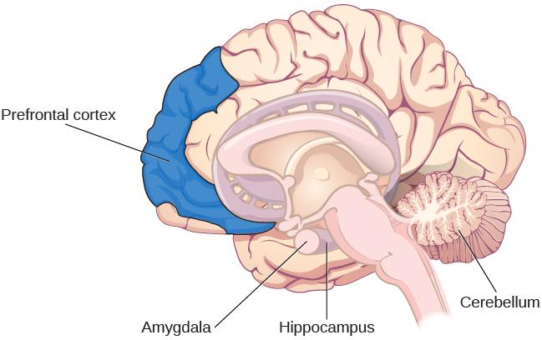
PARTS OF THE BRAIN INVOLVED IN MEMORY
Notes:
Scientists have now identified different parts of the brain involved in memory.

Slide 52
PARTS OF THE BRAIN INVOLVED IN MEMORY
Amygdala
Involved in fear and fear memories (memory storage is influenced by stress hormones).
Processes emotional information important in encoding memories at a deeper level and memory consolidation.
Hippocampus
Associated with explicit memory, recognition memory and spatial memory.
Projects information to cortical regions that give memories meaning and connect them with other memories.
Involved in memory consolidation.
Damage leads to an inability to process new declarative memories.
Notes:
Patient H.M:
Had both temporal lobes removed (including hippocami) to help control his seizures.
Declarative memory was significantly effected.
Could not form new semantic knowledge or episodic memories.

Slide 53
PARTS OF THE BRAIN INVOLVED IN MEMORY
Cerebellum
Plays a role in processing procedural memories, such as how to play the piano and classical conditioning.
Damage prevents classical conditioning such as an eye-blink in response to a puff of air.
Prefrontal cortex
Appears to be involved in remembering semantic tasks.
PET scans show activation in the left inferior prefrontal cortex when completing semantic tasks.
Encoding is associated with left frontal activity.
Retrieval of information is associated with the right frontal region.

Slide 54
NEUROTRANSMITTERS (1)
Communication among neurons via neurotransmitters is critical for developing new memories.
Repeated neuron activity → increased neurotransmitters in the synapse → stronger synaptic connections. (This is how memory consolidation occurs).
Neurotransmitters involved in memory:
Epinephrine
Dopamine
Serotonin
Glutamate
Acetylcholine
Notes:
Acetylcholine is important in AD

Slide 55
NEUROTRANSMITTERS (2)
Arousal Theory – strong emotions trigger the formation of strong memories and weaker emotional experiences form weaker memories.
Strong emotional experiences can trigger the release of neurotransmitters which strengthen memory.
Evidenced by flashbulb memories - an exceptionally clear recollection of an important emotional event.

Slide 56
AMNESIA
Retrograde
Anterograde
Event
Notes:
Amnesia – the loss of long-term memory that occurs as the result of disease, physical trauma, or psychological trauma.
There are 2 common types:
Anterograde amnesia – inability to remember new information after point of trauma.
Commonly caused by brain trauma.
Hippocampus is usually affected – causes inability to transfer information from STM to LTM.
Retrograde amnesia – loss of memory (partial or complete) for events that occurred prior to the trauma.

Slide 57
MEMORY CONSTRUCTION &
RECONSTRUCTION
Construction – formulation of new memories.
Reconstruction – process of bringing up old memories.
When we retrieve memories, we tend to unintentionally alter and modify them, resulting in inaccuracies and distortions.
Suggestibility
Suggestibility is the effects of misinformation from external sources that leads to the creation of false memories.
Can cause people to claim to remember something that was only a suggestion someone made.
Memories are fragile making them vulnerable to the power of suggestion.
An important area of study has been the role of suggestibility in eyewitness testimonies.

Slide 58
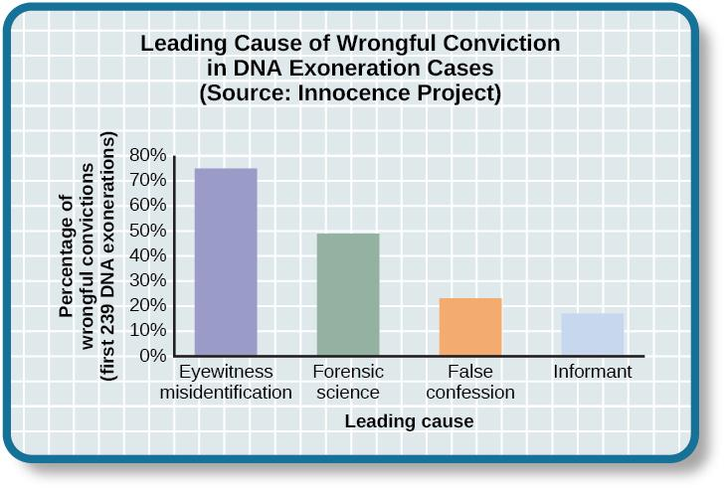
EYEWITNESS MISIDENTIFICATION
In studying cases where DNA evidence has exonerated people from crimes, the Innocence Project discovered that eyewitness misidentification is the leading cause of wrongful convictions (Benjamin N. Cardozo School of Law, Yeshiva University, 2009).
Notes:
Eyewitness identification and testimony is often used in the prosecution of criminals.
Research suggests that suggestive police identification procedures can lead to alterations in an eyewitnesses memory leading to misidentification.

Slide 59
THE MISINFORMATION EFFECT (1)
Elizabeth Loftus
Studied false memories.
Misinformation effect paradigm – after exposure to incorrect information, a person may misremember the original event.

Slide 60
THE MISINFORMATION EFFECT (2)
Study (1974):
Asked college students to estimate the speed of cars using different forms of questions.
Participants were shown films of car accidents and were asked to play the tole of eyewitness and describe what happened.
Were asked, “About how fast were the cars going when they (smashed, collided, bumped, hit, contacted) each other?”

Slide 61
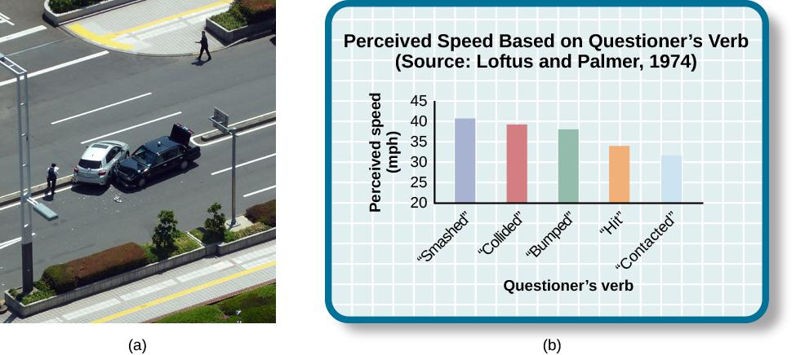
LOFTUS STUDY

Slide 62
THE MISINFORMATION EFFECT (3)
Study (1974):
Participants that heard the word smashed estimated that the cars were travelling a lot faster than those that heard the word contacted.
If they heard the word glass, they were more than twice as likely to say they remember seeing glass (a false memory).
The implied meaning of the word used influenced the participants memory of the accident.

Slide 63
REPRESSED & RECOVERED MEMORIES
A controversial topic within psychology is the idea that whole events can be repressed or falsely recalled.
False memory syndrome – recall of false autobiographical memories.
Repressed memories:
Some psychologist believe it is possible to completely repress traumatic childhood memories such as sexual abuse.
Can lead to psychological distress in adulthood.
Some believe that these can be recalled through hypnosis and guided imagery techniques.
Loftus challenges the idea of repressed memories and questions if recalled memories are accurate or whether the processes of questioning and suggestibility leads to the misinformation effect.

Slide 64
WHY DO WE FORGET? (1)
Forgetting – loss of information from long-term memory.
Encoding Failure
Encoding failure occurs when the memory is never stored in our memory in the first place.
Successful encoding requires effort and attention.
Notes:
The correct answer is C

Slide 65
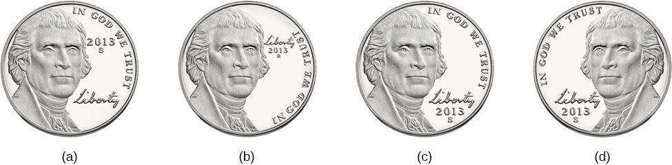
Notes:
Can you tell which coin is the accurate depiction of a US nickel?
Most American’s cannot tell which one because we do not encode the specific details, we just know enough to differentiate it from other coins.
Correct answer is C

Slide 66
MEMORY ERRORS
Schacter’s 7 sins of memory
Forgetting type:
Transience – Accessibility of memory decreases over time (storage decay).
Absentmindedness – Forgetting caused by lapses in attention.
Blocking – Accessibility of information is temporarily blocked (aka tip-of-the-tongue phenomenon).
Distortion type:
Misattribution – Source of memory is confused.
Suggestibility – False memories.
Bias – Memories distorted by current belief system.
Intrusion type:
Persistence – Inability to forget undesirable memories.

Slide 67
Methods of Studying False Memory (1 of 8)
Deese–Roediger–McDermott (DRM) paradigm
Used w/ word lists. Individuals study lists of thematically related words
Critical intrusion (Critical Lure): Non-presented, but related word. Absent from the list!
At test, participants often report the critical lure (~50%)
Notes:
Satisfies Learning Objective 3: Illustrate the measures that have been used to examine false memory, namely the Deese–Roediger–McDermott procedure, and the false-memory induction procedure.
Critical intrusion: The false memory created by a list in which all of the words are related or associated with the absent but suggested word.
Deese–Roediger–McDermott (DRM) procedure:
Used to induce false memories for items on word lists.
Associates to an unpresented word are given, and the unpresented word is often recalled.
Devised by Roediger and McDermott.
Effectiveness and flexibility of method:
Illustrated by Knott and Shah through an experimental study to determine the role of emotions in the production of false memories.
They concluded that DRM can be used to examine memory in emotional contexts.

Slide 68
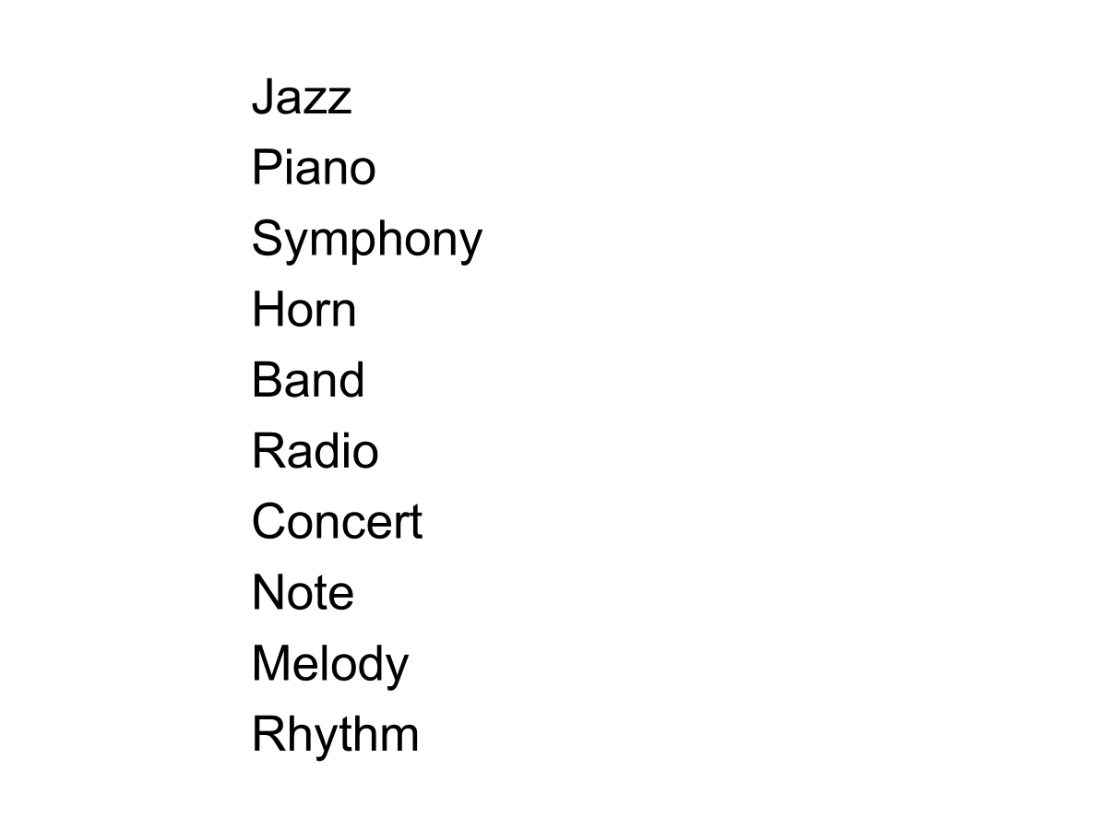
Methods of Studying False Memory (1 of 8)
Notes:
Satisfies Learning Objective 3: Illustrate the measures that have been used to examine false memory, namely the Deese–Roediger–McDermott procedure, and the false-memory induction procedure.
Critical intrusion: The false memory created by a list in which all of the words are related or associated with the absent but suggested word.
Deese–Roediger–McDermott (DRM) procedure:
Used to induce false memories for items on word lists.
Associates to an unpresented word are given, and the unpresented word is often recalled.
Devised by Roediger and McDermott.
Effectiveness and flexibility of method:
Illustrated by Knott and Shah through an experimental study to determine the role of emotions in the production of false memories.
They concluded that DRM can be used to examine memory in emotional contexts.

Slide 69
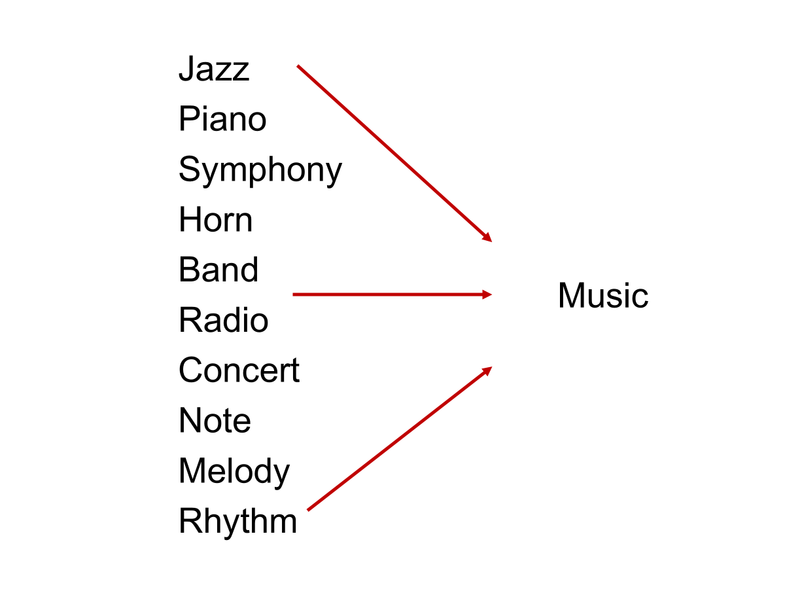
Methods of Studying False Memory (1 of 8)
Notes:
Satisfies Learning Objective 3: Illustrate the measures that have been used to examine false memory, namely the Deese–Roediger–McDermott procedure, and the false-memory induction procedure.
Critical intrusion: The false memory created by a list in which all of the words are related or associated with the absent but suggested word.
Deese–Roediger–McDermott (DRM) procedure:
Used to induce false memories for items on word lists.
Associates to an unpresented word are given, and the unpresented word is often recalled.
Devised by Roediger and McDermott.
Effectiveness and flexibility of method:
Illustrated by Knott and Shah through an experimental study to determine the role of emotions in the production of false memories.
They concluded that DRM can be used to examine memory in emotional contexts.

Slide 70

Methods of Studying False Memory (1 of 8)
Notes:
Satisfies Learning Objective 3: Illustrate the measures that have been used to examine false memory, namely the Deese–Roediger–McDermott procedure, and the false-memory induction procedure.
Critical intrusion: The false memory created by a list in which all of the words are related or associated with the absent but suggested word.
Deese–Roediger–McDermott (DRM) procedure:
Used to induce false memories for items on word lists.
Associates to an unpresented word are given, and the unpresented word is often recalled.
Devised by Roediger and McDermott.
Effectiveness and flexibility of method:
Illustrated by Knott and Shah through an experimental study to determine the role of emotions in the production of false memories.
They concluded that DRM can be used to examine memory in emotional contexts.

Slide 71
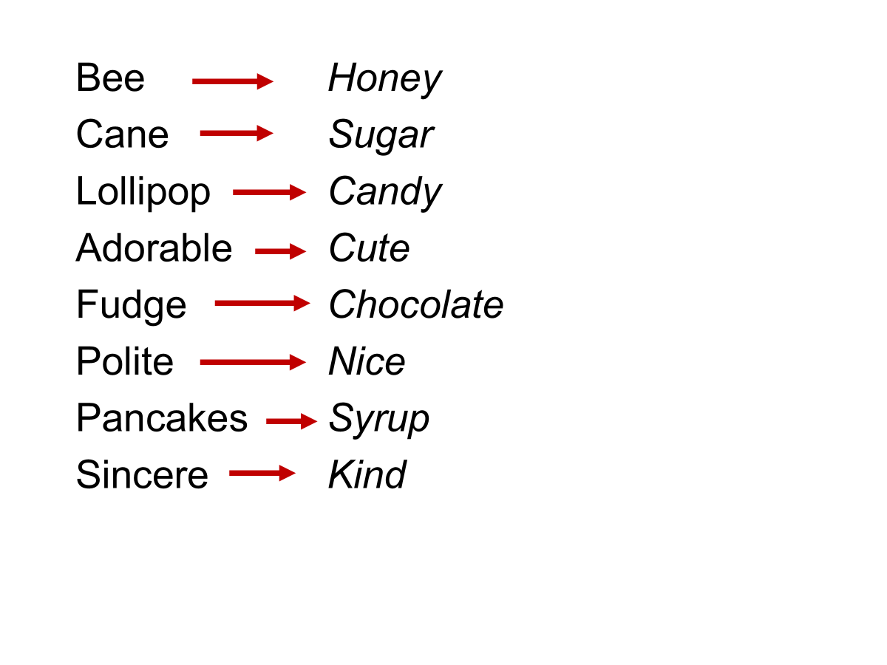
Methods of Studying False Memory (1 of 8)
Notes:
Satisfies Learning Objective 3: Illustrate the measures that have been used to examine false memory, namely the Deese–Roediger–McDermott procedure, and the false-memory induction procedure.
Critical intrusion: The false memory created by a list in which all of the words are related or associated with the absent but suggested word.
Deese–Roediger–McDermott (DRM) procedure:
Used to induce false memories for items on word lists.
Associates to an unpresented word are given, and the unpresented word is often recalled.
Devised by Roediger and McDermott.
Effectiveness and flexibility of method:
Illustrated by Knott and Shah through an experimental study to determine the role of emotions in the production of false memories.
They concluded that DRM can be used to examine memory in emotional contexts.

Slide 72
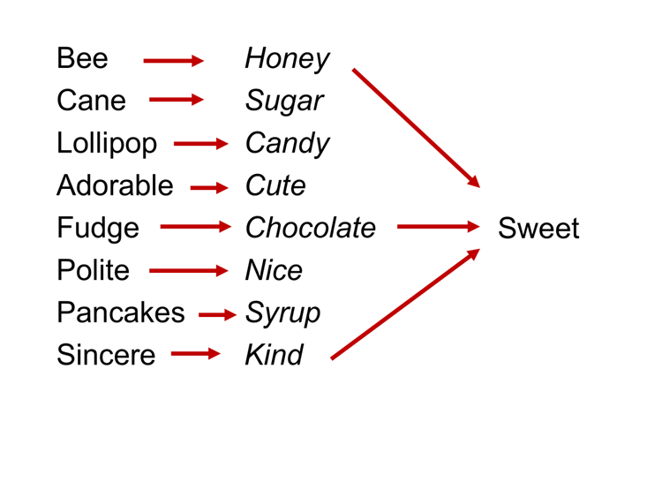
Methods of Studying False Memory (1 of 8)
Notes:
Satisfies Learning Objective 3: Illustrate the measures that have been used to examine false memory, namely the Deese–Roediger–McDermott procedure, and the false-memory induction procedure.
Critical intrusion: The false memory created by a list in which all of the words are related or associated with the absent but suggested word.
Deese–Roediger–McDermott (DRM) procedure:
Used to induce false memories for items on word lists.
Associates to an unpresented word are given, and the unpresented word is often recalled.
Devised by Roediger and McDermott.
Effectiveness and flexibility of method:
Illustrated by Knott and Shah through an experimental study to determine the role of emotions in the production of false memories.
They concluded that DRM can be used to examine memory in emotional contexts.

Slide 73
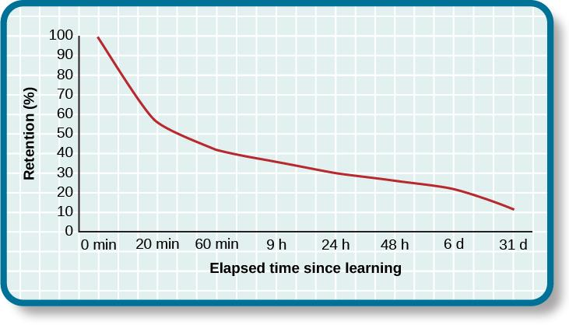
TRANSIENCE/STORAGE DECAY
Notes:
Overtime, unused information tends to fade away.
Ebbinghaus (1885)
Studied the process of memorization.
The Ebbinghaus forgetting curve shows how quickly memory for new information decays.
50% after 20 minutes.
70% after 24 hours.

Slide 74
BIAS
According to Schacter, your feelings and view of the world can distort your memory of past events.
Stereotypical bias - involves racial and gender biases.
After presenting people with a list of names, they more frequently incorrectly remembered typical African American names to be associated with the occupation basketball player, and typical white names to be associated with the occupation politician.
Egocentric bias – involves enhancing our memories of the past.
People remember events in a way that makes them look better.
Hindsight bias – the tendency to think an outcome was inevitable after the fact.
Thinking you knew it all along.

Slide 75
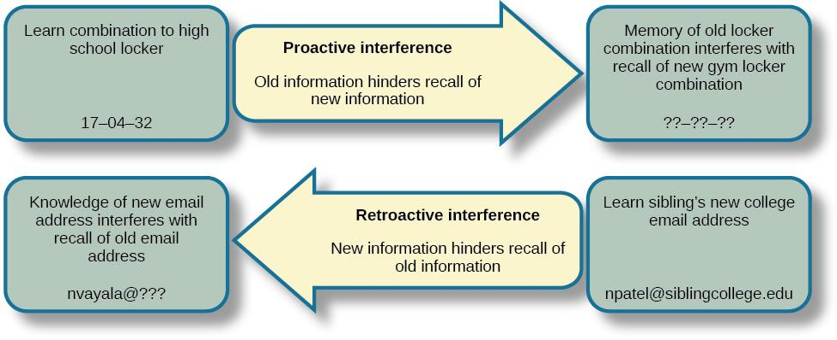
INTERFERENCE
Notes:
Sometimes forgetting is caused by a failure to retrieve information. This can be due to interference, either retroactive or proactive.

Slide 76
WAYS TO ENHANCE MEMORY
Rehearsal – conscious repetition of information to be remembered.
Chunking – organizing information into manageable bits or chunks.
E.g. Separating phone numbers into 3 chunks.
Elaborative rehearsal – technique in which you think about the meaning of the new information and its relation to knowledge already stored in your memory.
Mnemonic devices – memory aids that help us organize information for encoding.
E.g. One way to remember the order of planets is the name MR. VEM J. SON.
Other techniques can include:
Expressive writing.
Saying words aloud.

Slide 77

MNEMONIC DEVICES
Notes:
This is a knuckle mnemonic to help you remember the number of days in each month. Months with 31days are represented by the protruding knuckles and shorter months fall in the spots between knuckles.

Slide 78
HOW TO STUDY EFFECTIVELY
Use elaborative rehearsal – link information to other information/memories to make it more meaningful.
Apply the self-reference effect – make information personally meaningful to YOU.
Don’t forget the forgetting curve – keep studying to prevent storage decay.
Rehearse.
Be aware of interference – study without distractions.
Keep moving – aerobic exercise promotes neurogenesis (growth of new brain cells in the hippocampus).
Get enough sleep – the brain consolidates memories while sleeping.
Make use of mnemonic devices.

